Slide 1

Theory Building
Chapter 3
Business Research Methods - William G. Zikmund

Slide 2
What is a Theory?
A theory consists of a coherent set of general propositions that offer an explanation of some phenomena by describing the way other things correspond to this phenomena.
A theory is a formal, testable explanation of some events that includes explanations of how things relate to one another.
A theory can be built through a process of reviewing previous findings of similar studies, simple logical deduction, and/or knowledge of applicable theoretical areas.
If a theory does not hold true in practice, then that theory holds no value.
Sudha Bhagavatheeswaran, Department of Information Technology,
SIES College of Arts, Science & Commerce (Autonomous)

Slide 3
Goals of Theory
Understanding
Predicting
Understanding
Gain an understanding of the relationship among various phenomena.
Enables us to predict the behavior or characteristics of one phenomenon from the knowledge of another phenomenon
.
Sudha Bhagavatheeswaran, Department of Information Technology,
SIES College of Arts, Science & Commerce (Autonomous)
Notes:
© Copyright PresentationGO.com – The free PowerPoint and Google Slides template library

Slide 4
Research Concepts and Constructs
A concept or construct is a generalized idea about a class of objects, attributes, occurrences, or processes that has been given a name.
Concepts are the building blocks of theory.
Concepts abstract reality.
Ladder of abstraction:- Organization of concepts in sequence from the most concrete and individual to the most general.
Sudha Bhagavatheeswaran, Department of Information Technology,
SIES College of Arts, Science & Commerce (Autonomous)

Slide 5
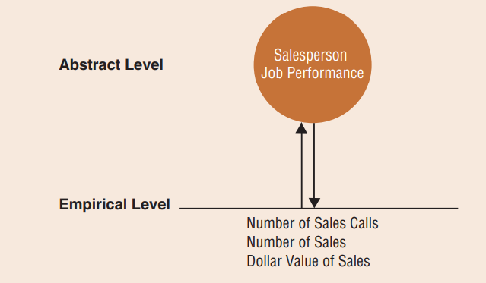
Research Concepts and Constructs
Abstract level: In theory development, the level of knowledge expressing a concept that exists only as an idea or a quality apart from an object.
Empirical level: Level of knowledge that is verifiable by experience or observation.
Latent construct:- A concept that is not directly observable or measurable, but can be estimated through proxy measures. Eg :- Job performance, customer satisfaction, and risk aversion.
Sudha Bhagavatheeswaran, Department of Information Technology,
SIES College of Arts, Science & Commerce (Autonomous)

Slide 6
Research Propositions and Hypotheses
Propositions are statements concerned with the relationships among concepts.
A proposition explains the logical linkage among certain concepts by asserting a universal connection between concepts.
A hypothesis is a formal statement explaining some outcome.
A hypothesis is a proposition that is empirically testable.
When one states a hypothesis, it should be written in a manner that can be supported or shown to be wrong through an empirical test.
For example, using the color of the background for a Web site, the researcher may use theoretical reasoning to develop the following hypothesis:
H1: A web site with a blue background will generate more sales than an otherwise identical Web site with a red background
Sudha Bhagavatheeswaran, Department of Information Technology,
SIES College of Arts, Science & Commerce (Autonomous)

Slide 7
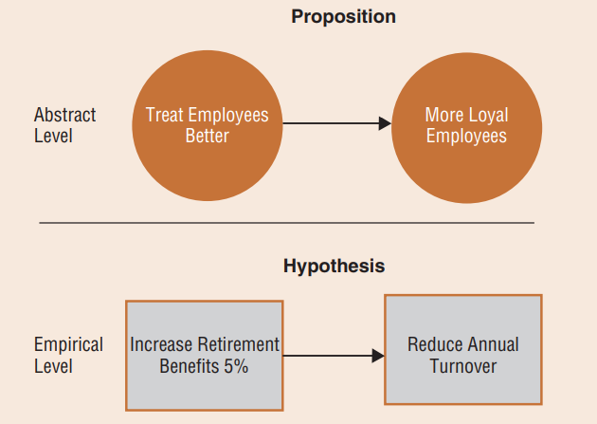
Research Propositions and Hypotheses
Empirical testing means that something has been examined against reality using data.
Retirement benefits and intention to leave are variables, reflecting the concepts of employee treatment and employee loyalty.
Operationalizing the variables.
When the data are consistent with a hypothesis, we say the hypothesis is supported else, not supported.
Sudha Bhagavatheeswaran, Department of Information Technology,
SIES College of Arts, Science & Commerce (Autonomous)

Slide 8
Theory Building
Deductive reasoning
The logical process of deriving a conclusion about a specific instance
based on a known general premise or something known to be true.
Inductive reasoning
The logical process of establishing a general proposition on the basis
of observation of particular facts
Sudha Bhagavatheeswaran, Department of Information Technology,
SIES College of Arts, Science & Commerce (Autonomous)

Slide 9

Scientific Method
Proposal of an explanation of the phenomenon and statement of new problems raised by the research
Assessment of relevant existing knowledge of a phenomenon
01
07
06
02
Formulation of concepts and propositions
Analysis and evaluation of data
03
05
Acquisition of meaningful empirical data
04
Statement of hypotheses
Design of research to test the hypotheses
Sudha Bhagavatheeswaran, Department of Information Technology,
SIES College of Arts, Science & Commerce (Autonomous)

